Slide 1
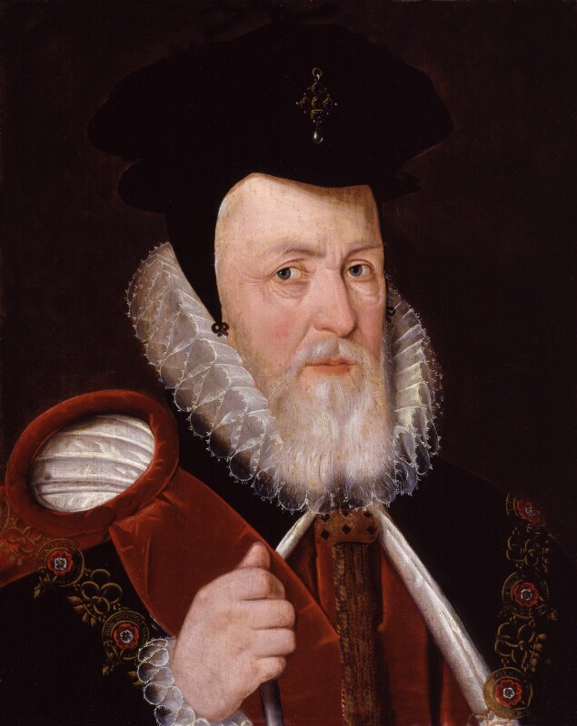
Now use your risk assessment to answer the question.
‘The threat of invasion was Elizabeth’s main problem when she became queen in 1558.’ How far do you agree? (16)
Explain your answer.
You may use the following in your answer:
France
Elizabeth’s legitimacy
You must also use information of your own
Start with your answer. Do you agree or disagree? Why?
Point
This should be one sentence outlining what the paragraph will be about
Paragraph 1 – The Threat of Invasion
Paragraph 2 – Elizabeth’s Legitimacy
Paragraph 2 – Add one of your own…
Evidence
Aim for 2 sentences. You should give the facts here. What happened? Who was involved? When did it happen?
Explain
This is where you are linking back to the question. How did the information you gave in the evidence part explain why it happened?
Analyse
Link your paragraph back to the your conclusion. Made a judgement, how important is this factor to the statement in the question.
Wrap up everything you’ve said and link it all to your conclusion.

